Slide 1
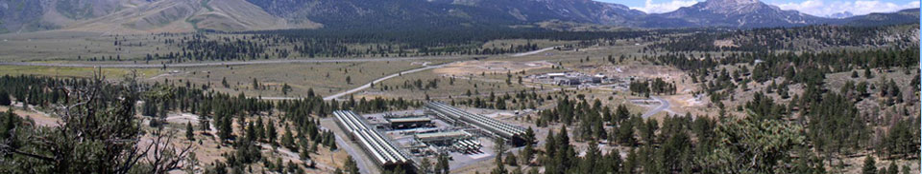
Vegetation and Mineral Alteration near Mammoth Geothermal Complex, Mono County, CA
May 2, 2019
Mads O’Brien
Yale School of Forestry & Environmental Studies
Notes:
Start talking about mammoth geothermal complex here

Slide 2
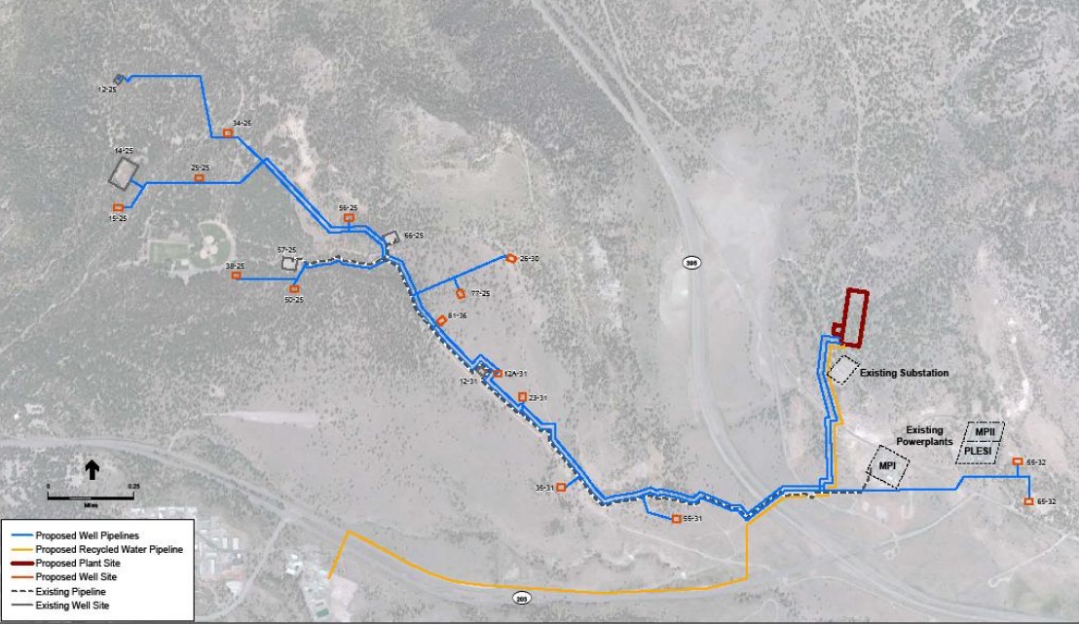
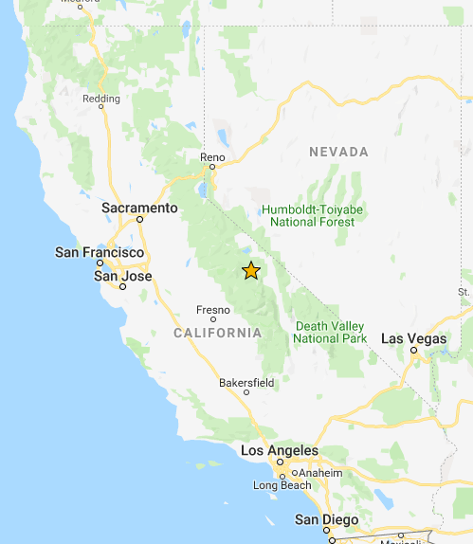
Mammoth Geothermal Complex (MGC)
3 power plants
Generates 29 Megawatts
Powers 22,000 homes
Owned by Ormat

Slide 3
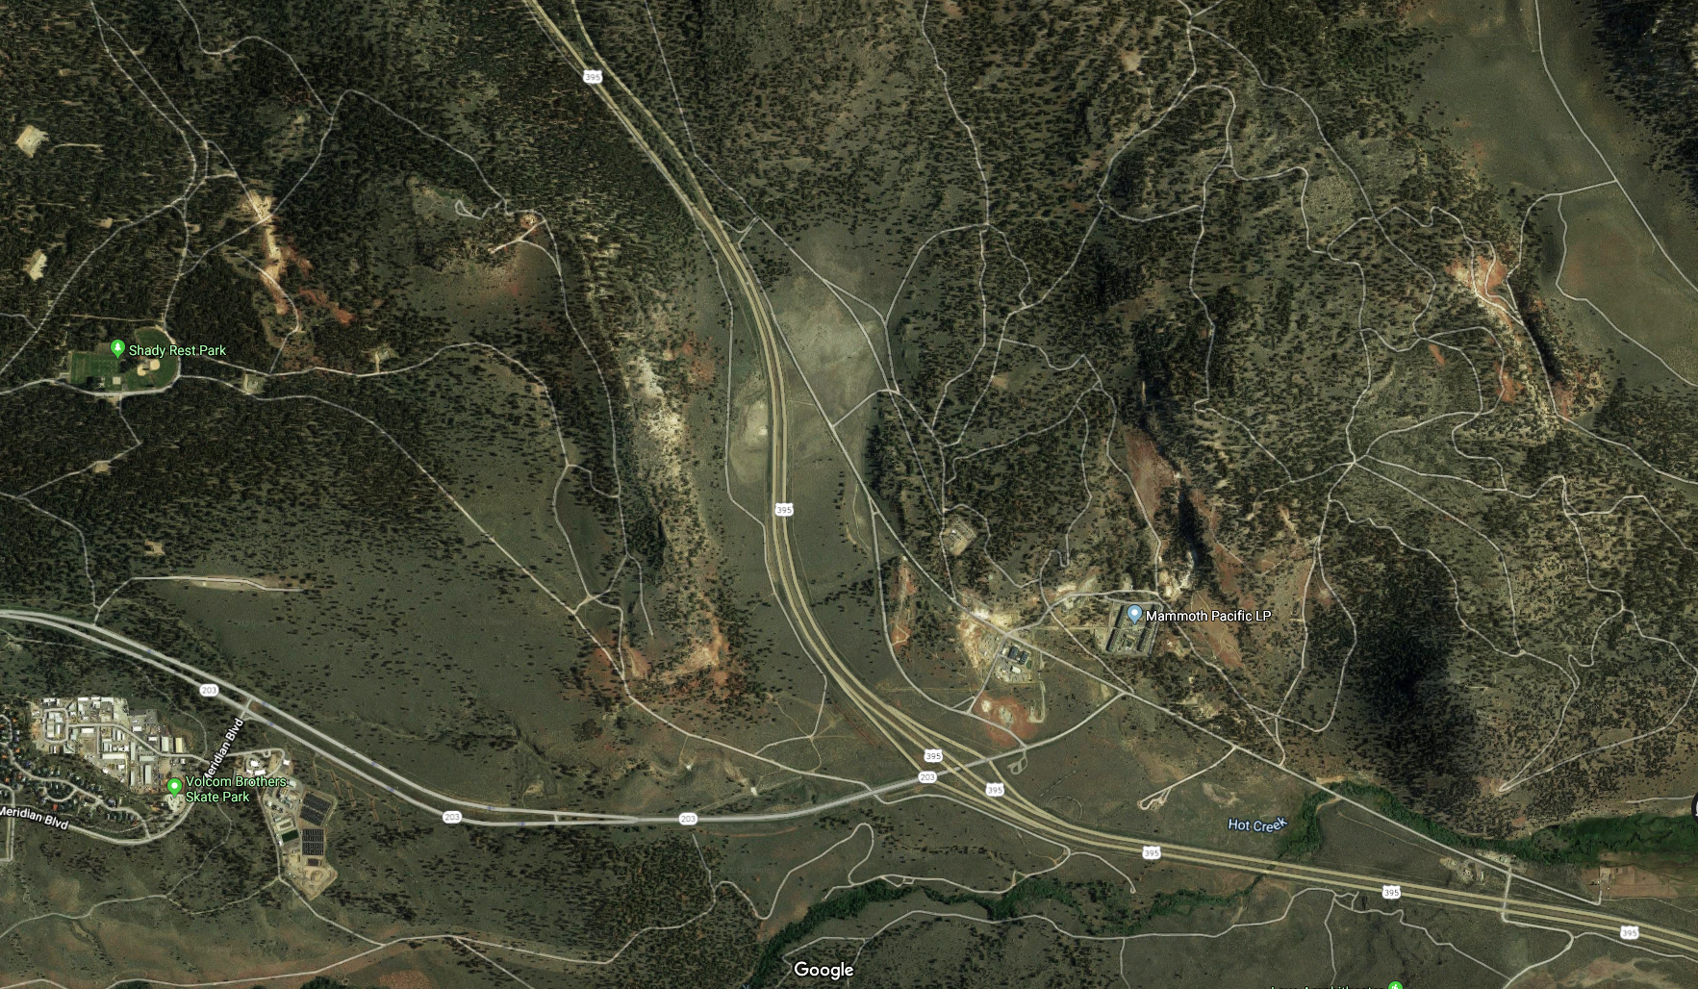
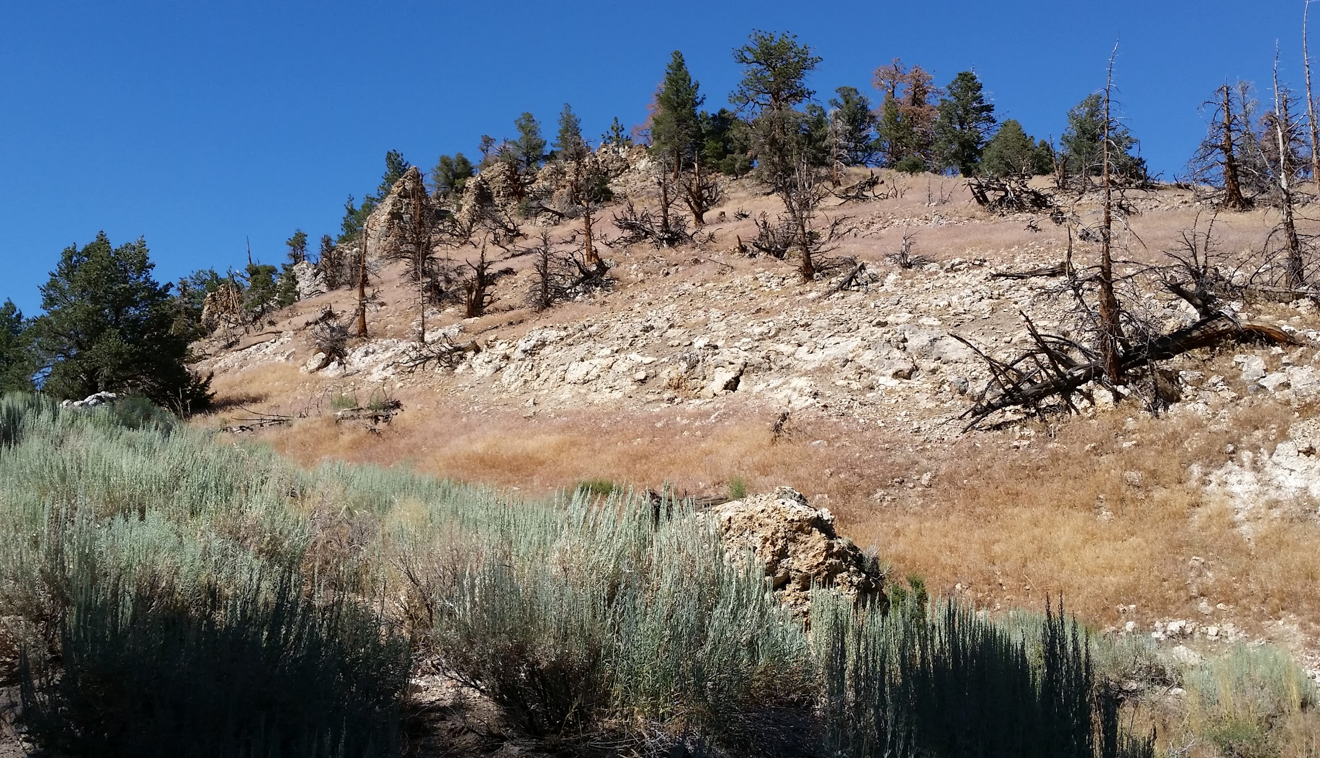
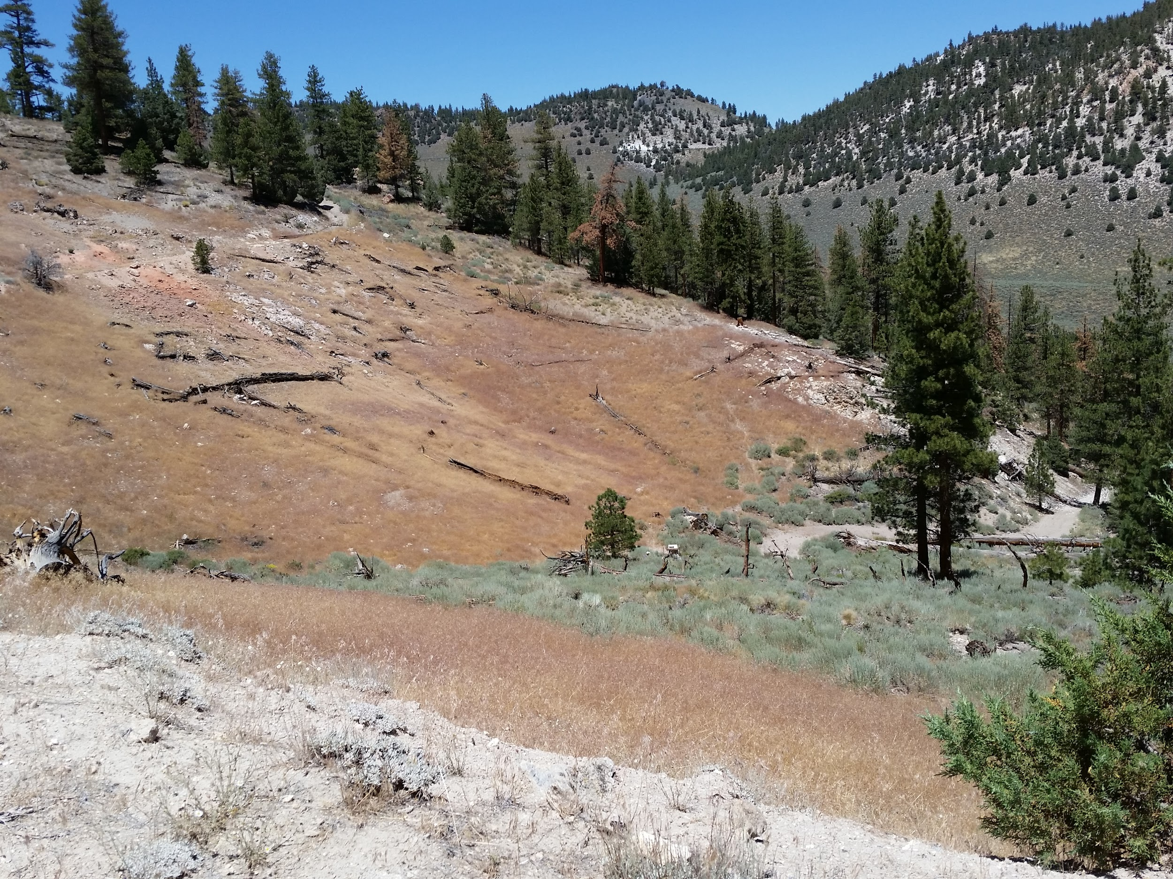
Aerial image of site, polygons of potential TKAs
Basalt Canyon, 2016
Fumerole Valley, 2016
Notes:
State the size in Square KM of my image AOI. Average size of the TKAs, list the smallest one and the largest one to give context.
Has been enhanced contrast and brightness.

Slide 4
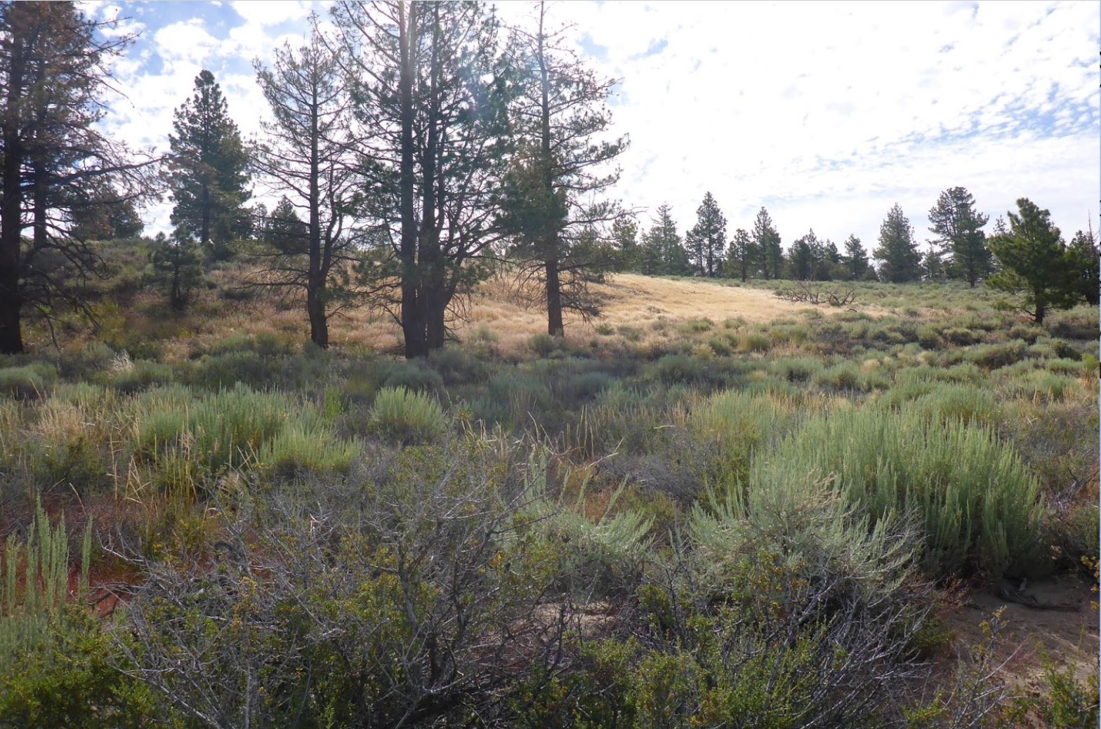
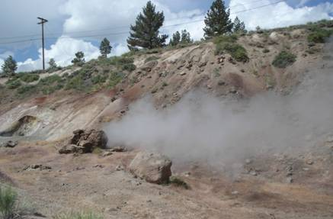
Research Questions
What vegetation changes occur around MGC over time?
What mineralogical changes occur around MGC over time?
Do vegetation & mineral changes correlate with development at the power plant?
Notes:
For my project, I wanted to explore a suite of remote sensing methods to see what surface change I could detect over time, and any qualitative correlations between development at the site and surface changes.
Photo cred: me
http://www.indiana.edu/~sierra/papers/2009/bower-bir.html
https://www.linkedin.com/pulse/heated-debate-over-casa-diablo-iv-geothermal-project-raymi-castilla

Slide 5
Timeline of Ormat operations at MGC
Wellfield expanded west of the power plants
Replaced equipment at MP1
1st plant opened (MP1)
1990
2006
2004 - 2007
2012 - 2018
1984
2005
2014
2 new plants (MP2 and PLES-1)
CD-IV expansion developed, 2 wells connected to existing plants
Notes:
1984:
1990: G2 (MPII) and G-3 (PLES-1) came online
2005, the wellfield was expanded into what is known as Basalt Canyon west of the power plants
The proposed area that will provide geothermal fluid to the CD IV expansion was developed in 2006 with two production wells that are already connected to the existing plants
Ormat repowered the G1 power plant in 2014 replacing equipment

Slide 6
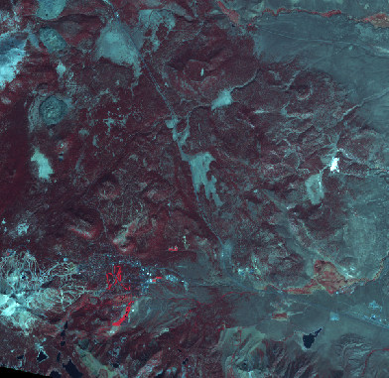
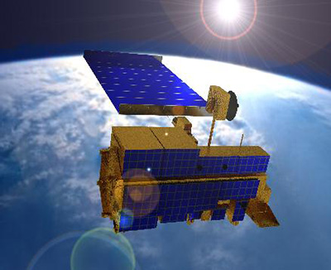
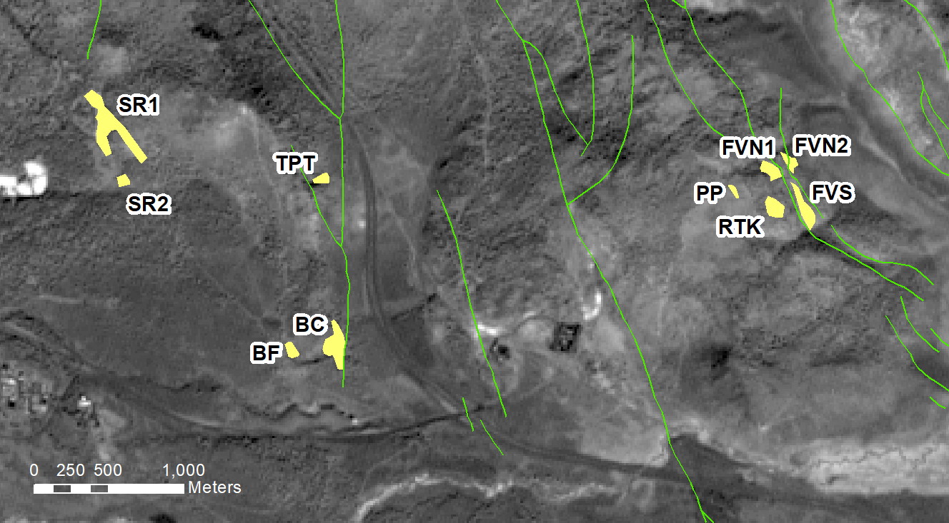
Data utilized
ASTER timeseries (10 images)
“Ground-truthed” regions of interest (10 ROIs)
Faultline shapefiles
Ormat infrastructure, digitized from maps
Notes:
ASTER is onboard Terra
I chose ASTER because decent amount of ASTER images had been tasked in my region. My areas were small, so 15-m visible resolution was nice.
SWIR bands allows me to look at minerals, and these images are already aligned with the visible so they’re easier to compare!
Also, I’d never worked with it before and wanted to explore it.
Total images: 10 separate years
Years: 2000… 2004, 05, 06, 07 … 12, 13, 15, 16, 18
This was based on availability, what was cloud free in earth explorer, and relatively snow free
Range of seasons: April 26 - Sept 29,
6/10 of images were taken ⅘ of images … Most of images were taken May, June, July
These are a combo of areas I digitized from previously published papers, and ones I digitized from aerial photos.

Slide 7
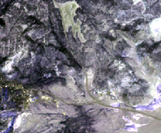
Pre-processing, by band
Analysis, by year
DN
VIS (2000-2018)
SWIR (2000-07)
Spatial Subset
At-Sensor Radiance
ToA Reflectance
Surface Ref. (QUAC)
2000
-1 to 1
NDVI
2018
Reflectance
VIS
SWIR
~1 +
2000
Alteration Index B4 / B6
2007
~1 +
2000
Kaolinite Index (B4/B5) x (B8/B6)
2007
~1 +
2000
Alunite Index (B7/B5) x (B7/B8)
2007
Notes:
Preprocessing steps
Calculation of indices: NDVI and alteration index
How veg data was treated vs mineral data
What statistics were calculated
Cropped all my images to an AOI that excluded the nearby ski mountain and really bright snow spots, because this would skew my atmospheric correction I think. But still kept it large enough so that I could “explore” other areas beyond the power plant where surface changes may have occurred
Alteration ratio: number above 1 indicates alteration minerals present
Ratio of band 4 and band 6 (give wavelengths) indicate clays, presence of hydrothermal alteration.
Example: one paper that used this ratio identified altered ground in Yellowstone NP (which has similar geologic setting to this: minerals altered on the surface due to volcanically driven water and gases moving under the surface)
Lots of ways to measure this, but a simple start. Exploratory.

Slide 8
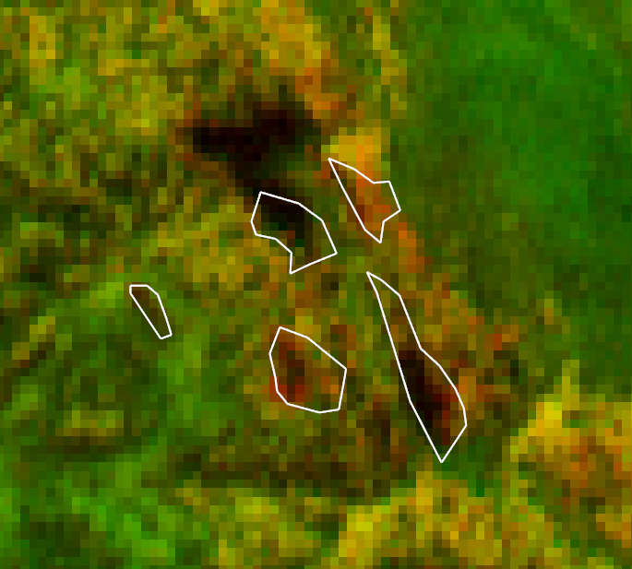
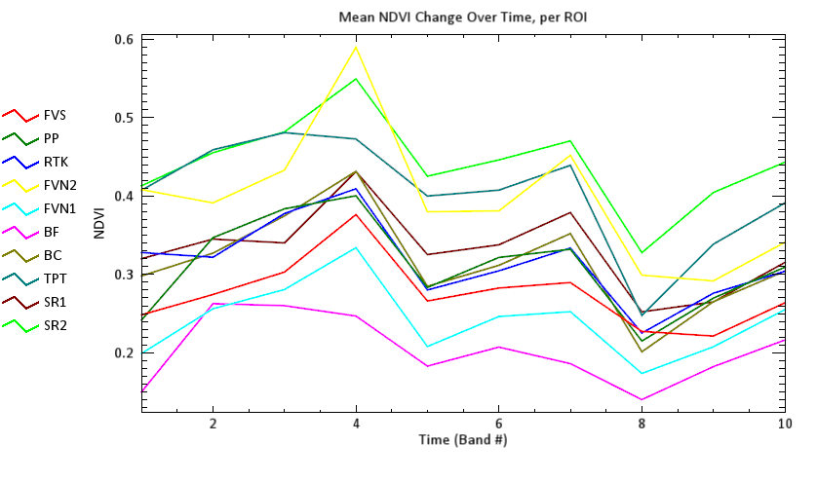
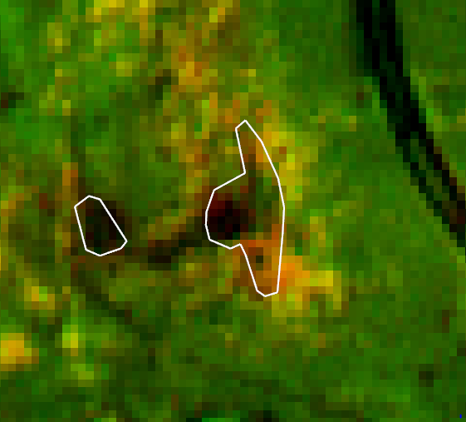
Results: Vegetation change
2000 → 2018
2004
2007
2015
2000 → 2018
Notes:
Include graphs
Screenshot a few images of particular TKAs with notable change in NDVI!
Here is the first time where I noticed -- a lot of my NDVI difference comes in differences in illumination in my scenes. I won’t go into it during this presentation, but I’m trying to figure out a way to remove this pattern that I recognize is due to illumination to leave the real “signal” behind.
What I paid attention to instead, was where sites changed dramatically over my important time points.
Fumerole valley north lost trees between 2000-2007, compared to the already barren land around it? RTK didn’t seem to lose NDVI as much.

Slide 9
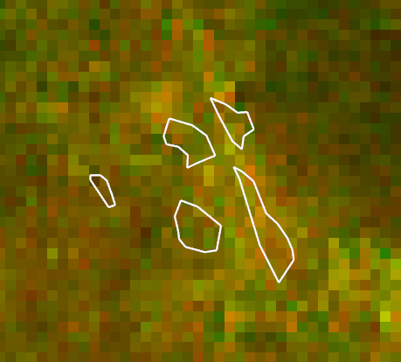
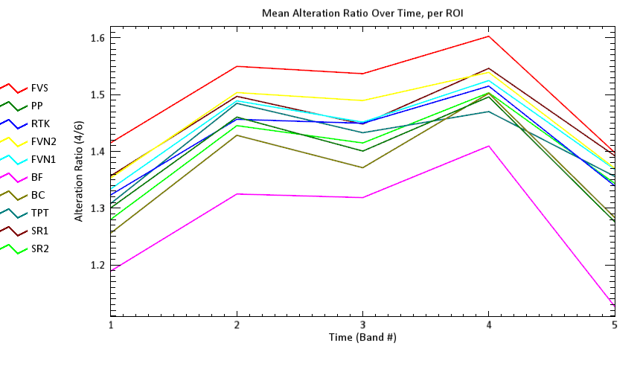
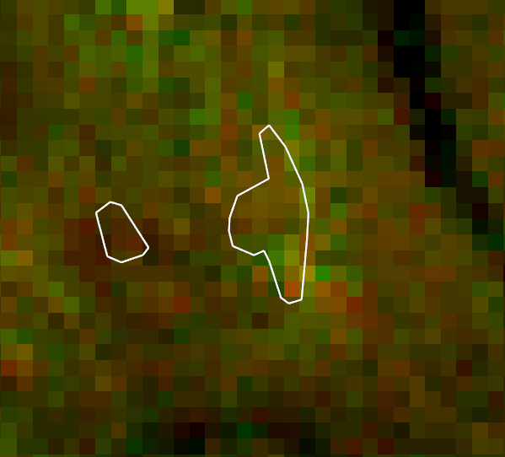
Results: Alteration index
2000 → 2007
2004
2006
2000 → 2007

Slide 10
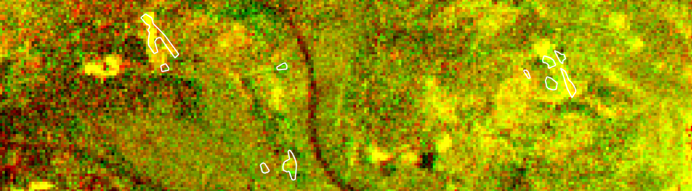
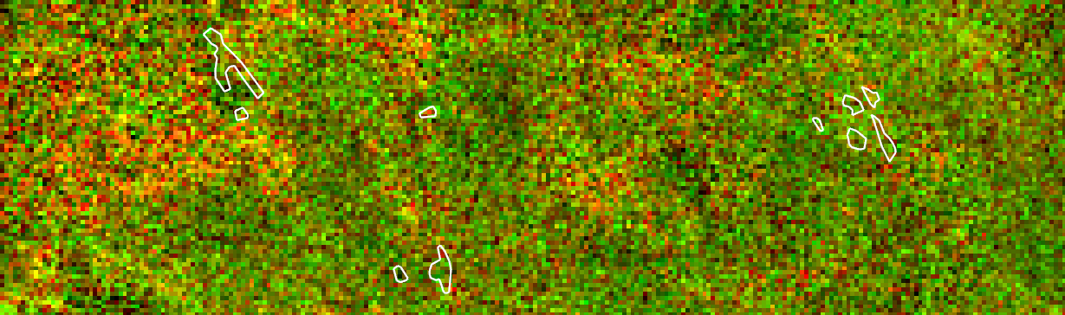
Kaolinite and alunite indices? Quite unhelpful.
Kaolinite ‘00-‘07
Alunite ‘00-‘07
Notes:
Kaolinite corresponds with the park grass, also….

Slide 11
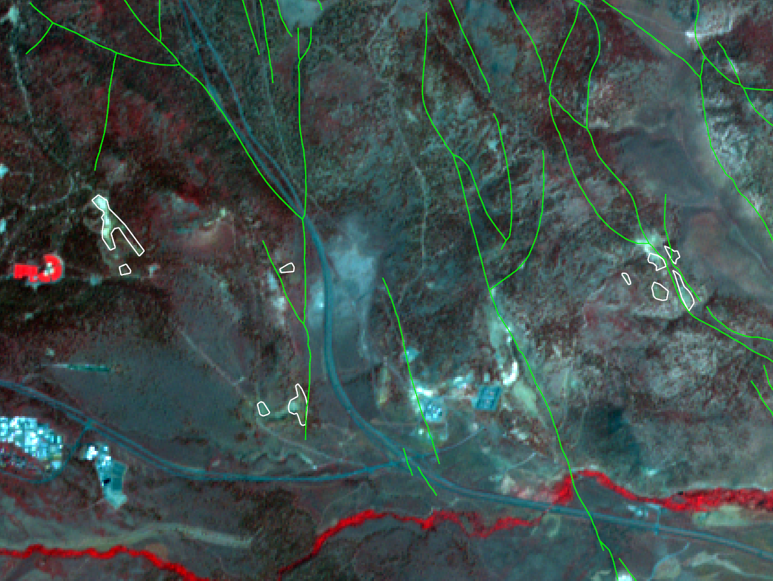
Fault proximity to tree kill zones
Notes:
Putting this in context: Proximity to faults and infrastructure
Pictures of how close my TKAs are to fault lines, pipelines, well pads.

Slide 12
Conclusions
Mineral change via SWIR isn’t useful to detect increased hydrothermal activity at this spatial scale.
Mineral change is correlated too strongly with lack of vegetation, not modern alteration.
Vegetation is changing, but illumination/alignment issues between ASTER images make it hard to quantify.

Slide 13
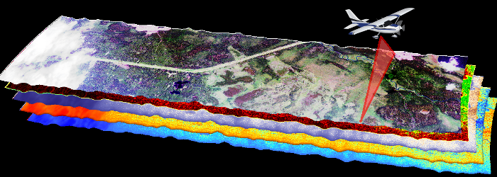
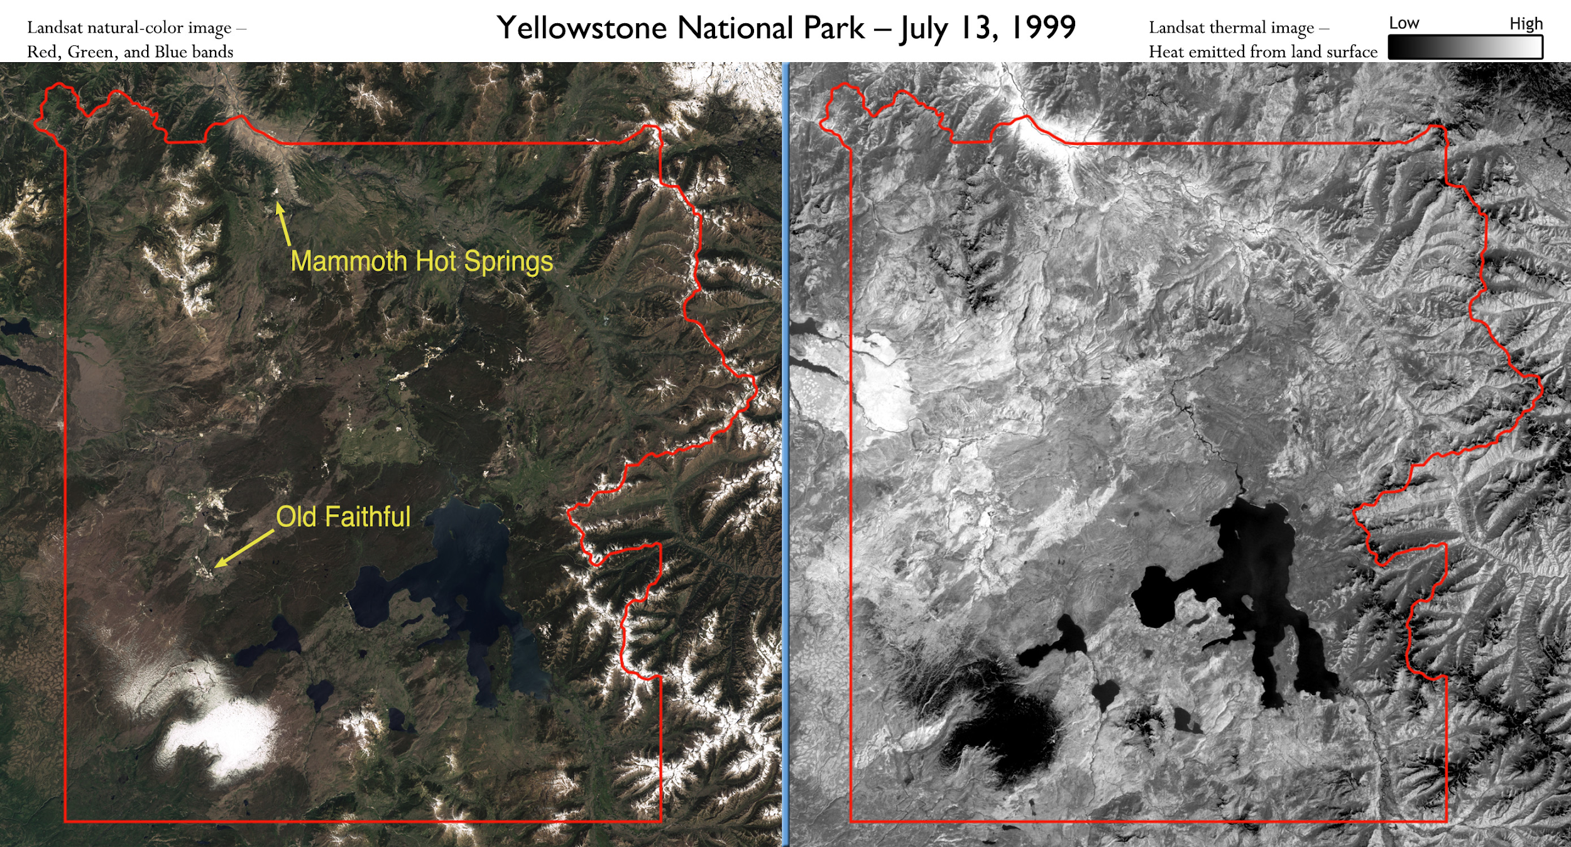
Next Steps
Use AVIRIS to map mineral changes
Higher accuracy
Greater temporal resolution (2012-2018)
Use higher spatial resolution imagery (Sentinel?) for NDVI to capture small differences
Incorporate thermal band
Notes:
Was my intention, but thought that a lot of the change I would see would be surface temps, seasonal… real heat anomalies are beneath the surface
Some thermal aerial data has been flown over the caldera, would be interesting to get my hands on that and see how it correlates with veg and mineral indices

Slide 15
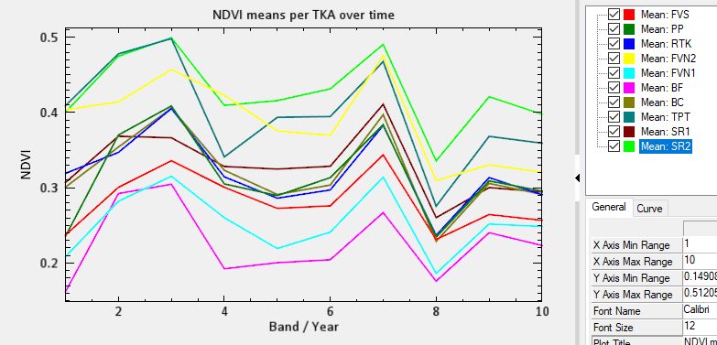
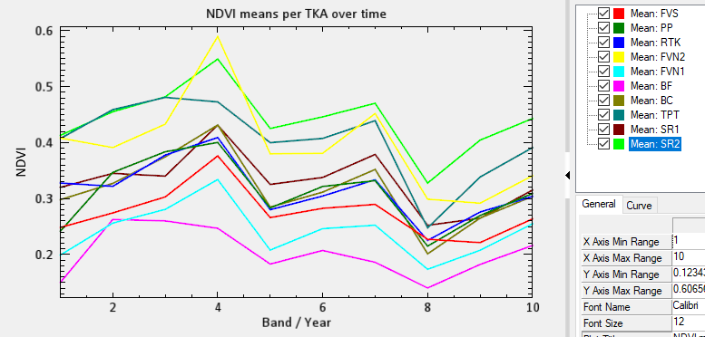
Effect of image extent on QUAC (and NDVI) results
Top image is LARGER extent, bottom is SMALLER extent.

